Slide 1
Azure Monitoring
v2
Notes:
This deck is a template for What The Hack lectures.
It is recommended that Coaches deliver mini-lectures ahead of each Challenge that set context for the challenge and introduce & explain any key technologies.
At a minimum, it is handy to have a slide with the key goals of each challenge to display on the screen when running the hack in-person.

Slide 2
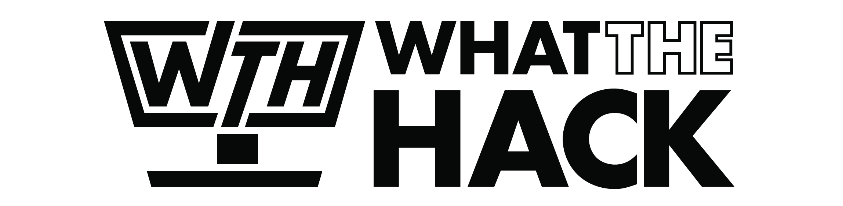
Azure Monitoring
Welcome & Intros
<Coach Name>
<Coach Name>
<Coach Title>
<Coach Title>
<Coach Name>
<Coach Name>
<Coach Title>
<Coach Title>
Notes:
Coaches/Presenters for THIS hack/lecture event should be listed on this slide.
Original contributors to the hack content & these slides include:
Please list original contributors to this hack here in the speaker notes and give them credit when delivering this content.
<Original Author 1>
<Original Author 2>
…
<Original Author N>

Slide 3
Challenge Zero
Get your machines ready!
Install Windows Subsystem for Linux (Bash Shell)
Install the Azure CLI (in WSL if on Windows!)
Install PowerShell Cmdlets for Azure
Install Visual Studio Code
Install ARM Tools extension for VS Code
Install Bicep extension for VS Code
Notes:
Modify this slide and add the pre-reqs specific to your hack here.
Each challenge slide should list the key goals for the challenge.

Slide 4
Challenge 1
Monitoring Basics: Metrics, Logs, Alerts and Dashboards
Notes:
After deploying your initial solution for eShopOnWeb, you want to make sure that the telemetry is collected from the VMs deployed and display the results on a dashboard for visualization and alerting purposes. By default Azure Monitoring collects only host-level metrics - like CPU utilization, disk and network usage - for all virtual machines and virtual machine scale sets without any additional software. For more insight into your virtual machines, you can collect guest-level log and performance data using Azure Monitor Agent.
To accomplish this task, you will need to understand the concept of metrics and logs, how to collect them into Azure Monitor, how to configure different types of alerts, and display results in an Azure Dashboard.
Once you have configured the dashboard, alerts, and diagnostics data to be collected, you will use two tools to simulate a load on the eShopOnWeb resources:
HammerDB - A benchmarking and load testing tool for the world's most popular databases, including SQL Server.
A custom script that produces CPU load on the eShopOnWeb website.

Slide 5
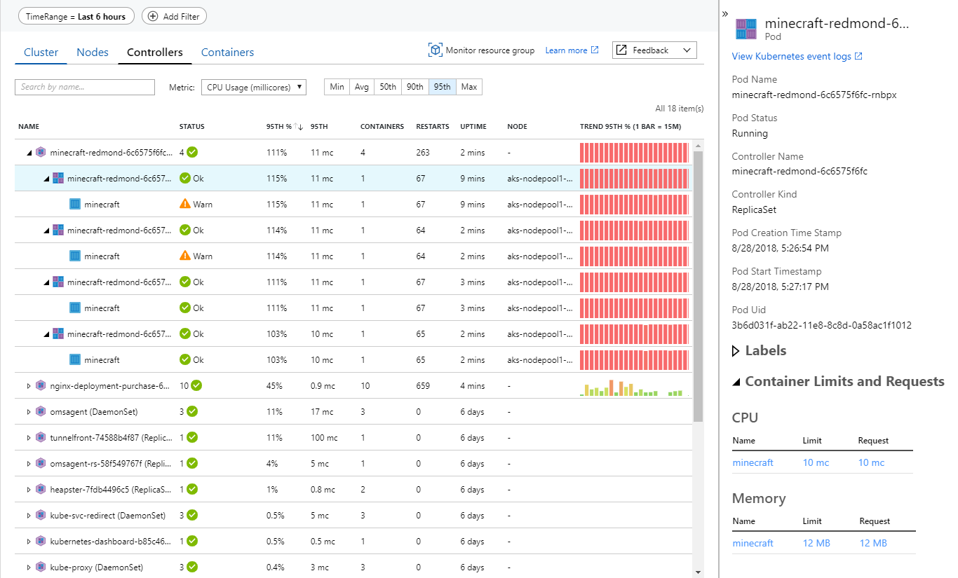
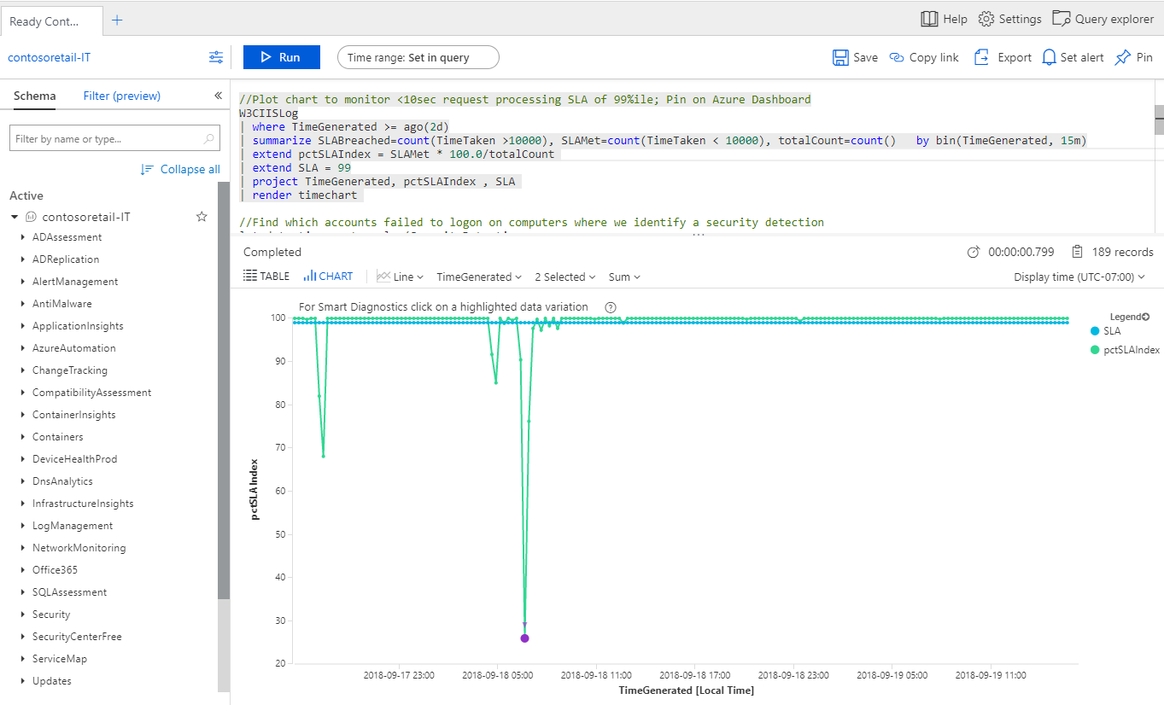
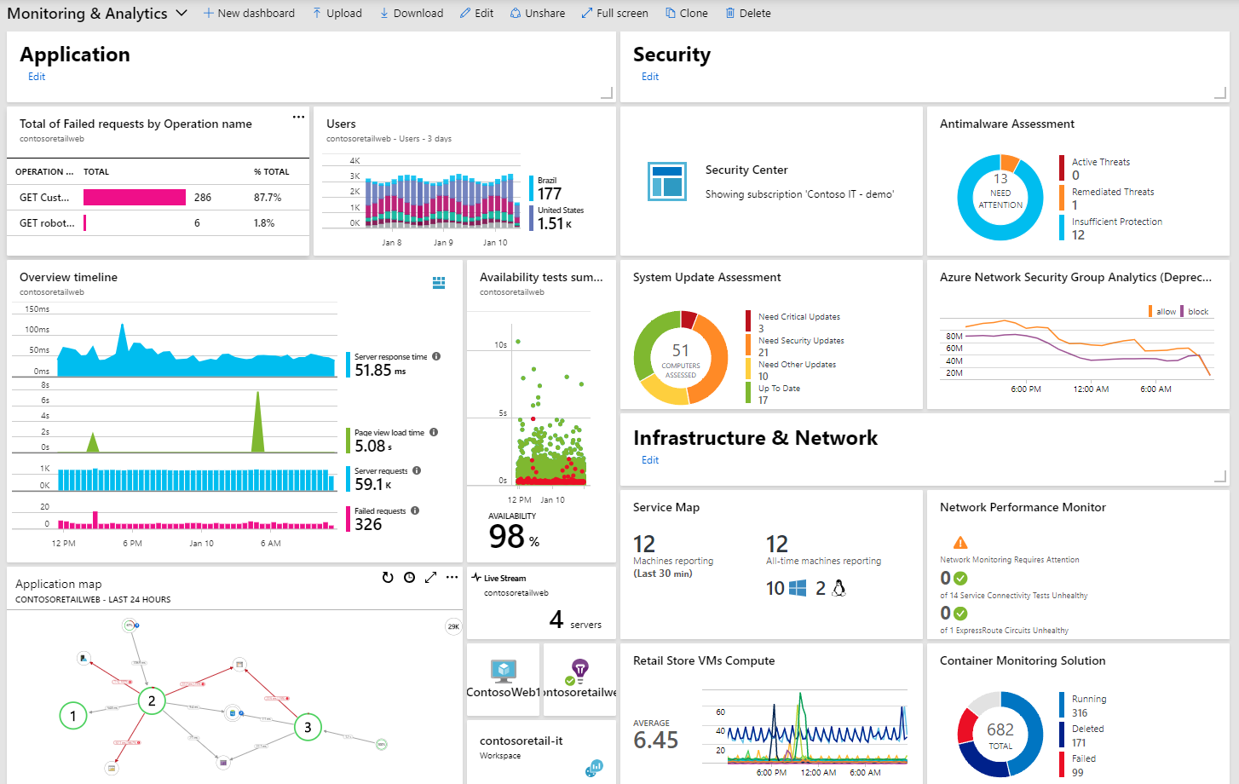
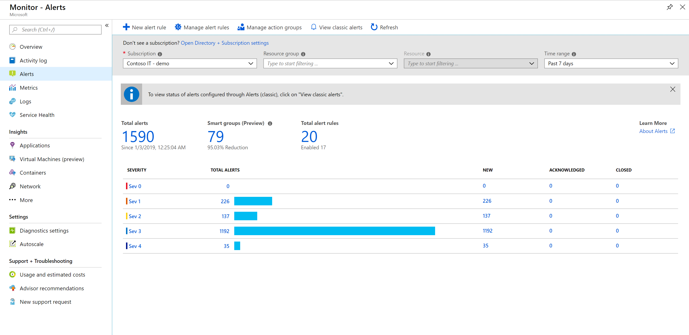
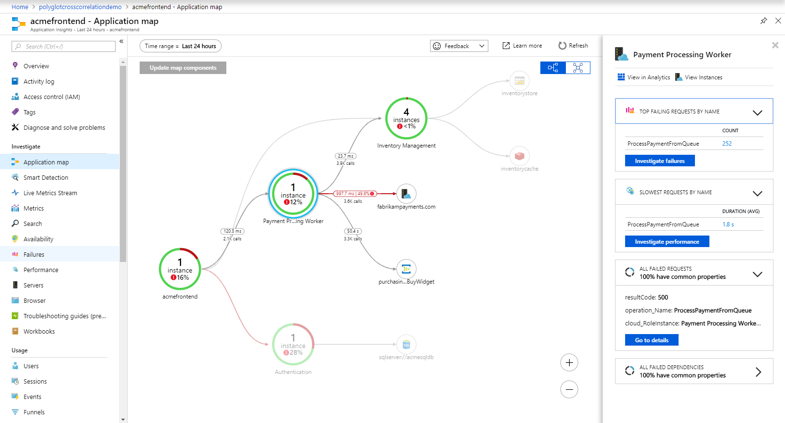
Azure Monitor
Observability Scenarios
Detect & diagnose issues across apps and dependencies with application insights
Correlate issues at infra level with insights for VMs, containers, network, etc.
Operationalize at scale with smart alerts and automated actions
Drill down with log analytics for troubleshooting & deeper diagnostics
Create visualizations with Azure dashboards, workbooks & Grafana
Notes:
Azure Monitor is a comprehensive monitoring solution for collecting, analyzing, and responding to telemetry from your cloud and on-premises environments.

Slide 6
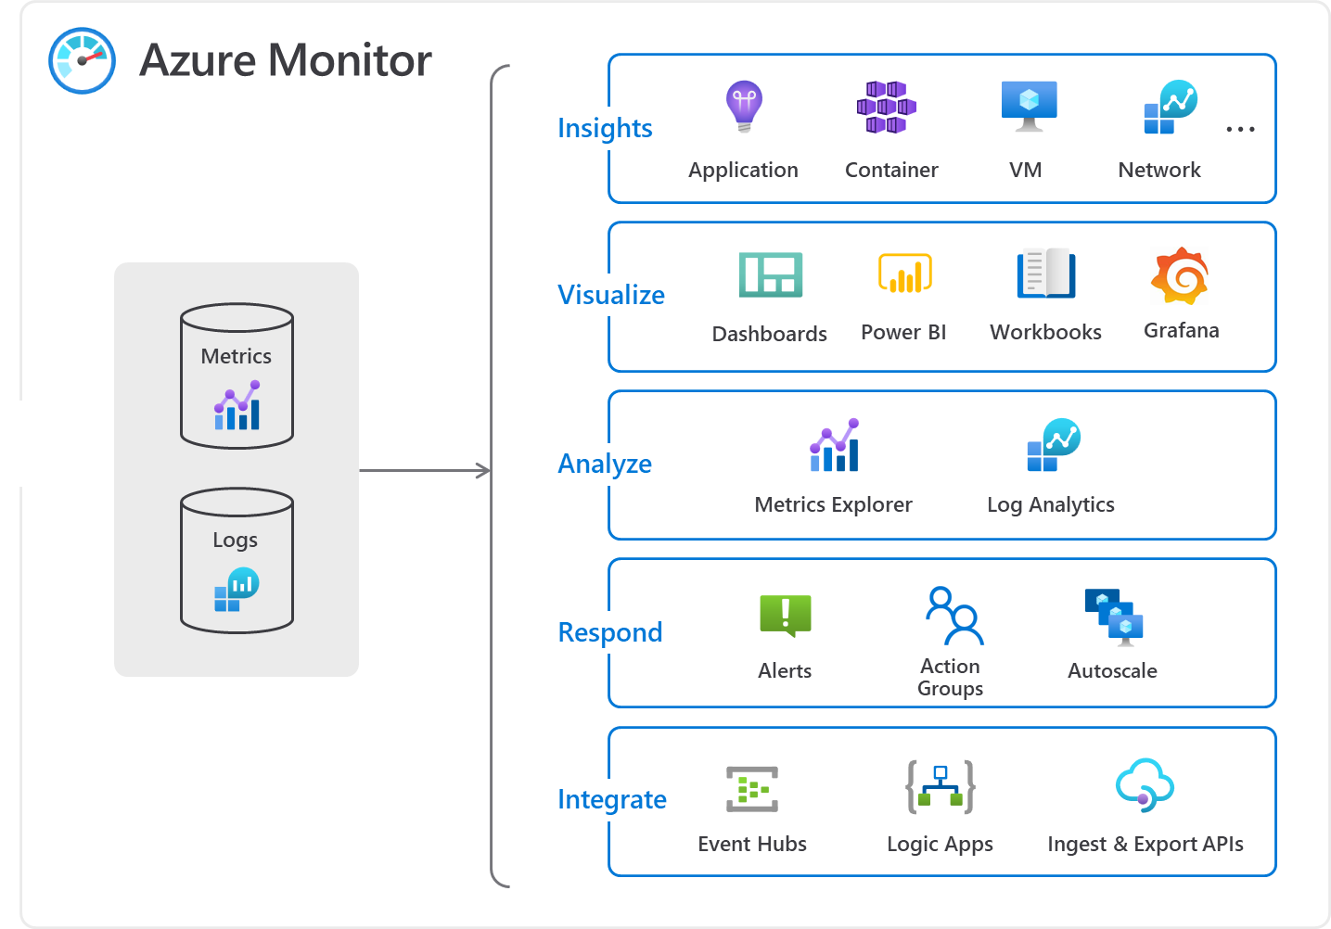
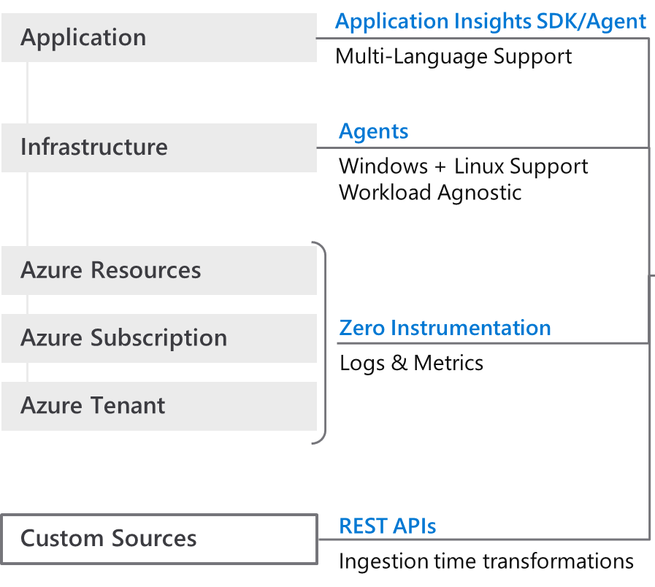
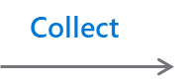
How Azure Monitor works
Notes:
So how does Azure Monitor work.
1) It all starts with collecting telemetry. Azure Monitor can collect data from Application, Network, Infrastructure and you can also ingest your own custom data. All the data is stored in centralized, fully managed logs and metrics stores. So what can you do with all the data:
Typically you start with insights which are end to end experiences we have put together for canonical scenarios or resources such as applications, containers, VMs, network, storage etc. Insights provide guidance and help troubleshoot and root cause issues quickly with a drill down experience.
You may in certain cases, just want to visualize the data. For that we provide Azure dashboards, Power BI integrations and a more native experience called Workbooks.
After visualizing the data, you may form some hypothesis and want to test them out. For that you need access to the raw data stores. For that we provide metrics explorer and a powerful big data platform called Log Analytics that is capable of querying petabytes of data within seconds.
If you want to pro-active and take corrective actions, you can create alerts and runbooks to auto remedy an issue. Or if it’s a capacity issue, you can choose to scale-in or scale-out
Finally, we know that monitoring isn’t done is silos. Azure Monitor provides out of the box integration with popular ITSM and DevOps tools. You can again use APIs, EventHub and Logic Apps to build custom integrations.
Azure Monitor Metrics and Logs
Azure Monitor Logs is a feature of Azure Monitor that collects and organizes log and performance data from monitored resources into Log Analytics workspaces. Azure Monitor Logs is one half of the data platform that supports Azure Monitor. The other is Azure Monitor Metrics, which stores lightweight numeric data in a time-series database. Azure Monitor Metrics can support near real time scenarios, so it's useful for alerting and fast detection of issues. Azure Monitor Metrics can only store numeric data in a particular structure, whereas Azure Monitor Logs can store a variety of data types that have their own structures. You can also perform complex analysis on Azure Monitor Logs data by using KQL queries, which can't be used for analysis of Azure Monitor Metrics data.

Slide 7
Agents in Azure Monitor
Required for VM guest-level telemetry collection
Azure Monitor Agent (AMA): Sends data from Azure VMs and on-prem machines to a Log Analytics workspace or Azure Monitor Metrics for use by features, insights, and other monitoring solutions and services. Azure Monitor Agent replaces all of Azure Monitor's legacy monitoring agents.
Log Analytics Agent (MMA/OMS): Legacy. To be retired 31 August 2024. Sends data from Azure VMs and on-prem machines to a Log Analytics workspace and supports monitoring solutions and services.
Diagnostics extension (WAD/LAD): Legacy. Sends data from Azure VMs to Azure Monitor Metrics (Windows only), Azure Event Hubs, and Azure Storage.
Telegraf agent: Legacy. Sends data to Azure Monitor Metrics (Linux only).
Dependency Agent: Collects data about processes running on the virtual machine and external process dependencies.
Notes:
By default Azure Monitoring collects only host-level metrics - like CPU utilization, disk and network usage - for all virtual machines and virtual machine scale sets without any additional software. For more insight into your virtual machines, you can collect guest-level log and performance data using Azure Monitor Agent.
Azure Monitor Agent (AMA) collects monitoring data from the guest operating system of Azure and hybrid virtual machines and delivers it to Azure Monitor for use by features, insights, and other services, such as Microsoft Sentinel and Microsoft Defender for Cloud. Azure Monitor Agent replaces all of Azure Monitor's legacy monitoring agents.
Azure Monitor Agent
Azure Monitor Agent collects monitoring data from the guest operating system of Azure and hybrid virtual machines and delivers it to Azure Monitor for use by features, insights, and other services. Azure Monitor Agent uses Data collection rules, where you define which data you want each agent to collect and where to send.
Note Azure Monitor Agent (AMA) replaces several legacy monitoring agents, like the Log Analytics Agent (Microsoft Monitoring Agent, MMA, OMS), Diagnostics agent and Telegraf agent. The legacy Log Analytics agent will not be supported after August 2024. For this reason, we will be using only the Azure Monitor Agent (AMA) in this Hackathon, we won't be using any of the legacy agents.

Slide 8
Azure Monitor Agent
Cost reduction
- Targeted data collection
- Data filtering, aggregation
Simplified management
- Multi homing
- Easily onboard -> deploy -> update at scale
- Transparency and control via extensibility
- Seamless management for Azure & hybrid
Security and performance
- Modern auth (MI, AAD)
- Higher EPS
- Efficient resource utilization
Single monitoring agent
- All data sources and data types
- All destinations
- All features in one
Notes:
Cost savings by using data collection rules:
Enables targeted and granular data collection for a machine or subset(s) of machines, as compared to the "all or nothing" approach of legacy agents.
Allows filtering rules and data transformations to reduce the overall data volume being uploaded, thus lowering ingestion and storage costs significantly.
Simpler management including efficient troubleshooting:
Supports data uploads to multiple destinations (multiple Log Analytics workspaces, i.e. multihoming on Windows and Linux) including cross-region and cross-tenant data collection (using Azure LightHouse).
Centralized agent configuration "in the cloud" for enterprise scale throughout the data collection lifecycle, from onboarding to deployment to updates and changes over time.
Any change in configuration is rolled out to all agents automatically, without requiring a client side deployment.
Greater transparency and control of more capabilities and services, such as Microsoft Sentinel, Defender for Cloud, and VM Insights.
Security and Performance
Enhanced security through Managed Identity and Azure Active Directory (Azure AD) tokens (for clients).
Higher event throughput that is 25% better than the legacy Log Analytics (MMA/OMS) agents.
A single agent that serves all data collection needs across supported servers and client devices. A single agent is the goal, although Azure Monitor Agent is currently converging with the Log Analytics agents.

Slide 9
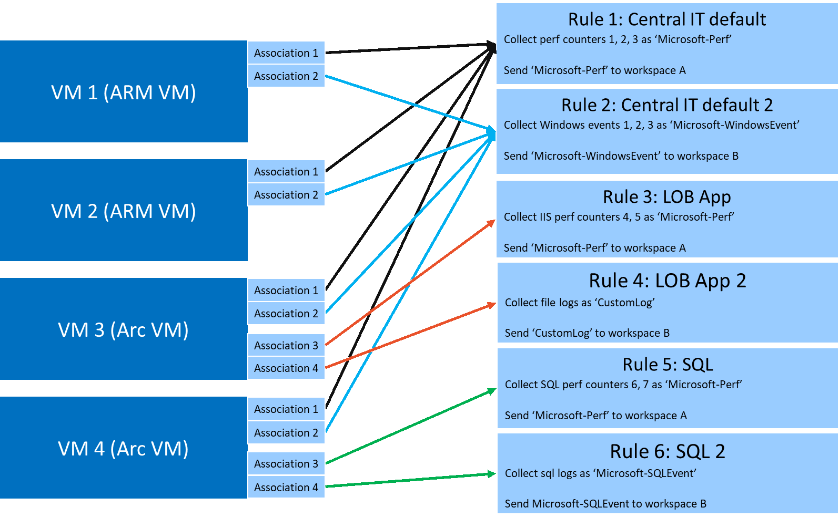
Azure Monitor Agent
Data Collection Rules
Best practices for data collection rule creation and management in Azure Monitor
Notes:
Data Collection Rules (DCRs) determine how to collect and process telemetry sent to Azure. Some data collection rules will be created and managed by Azure Monitor, while you may create others to customize data collection for your particular requirements. This article discusses some best practices that should be applied when creating your own DCRs.
When creating a DCR, there are some aspects that need to be considered such as:
The type of data that will be collected, also known as data source type (performance, events)
The target Virtual Machines to which the DCR will be associated with
The destination of collected data

Slide 10
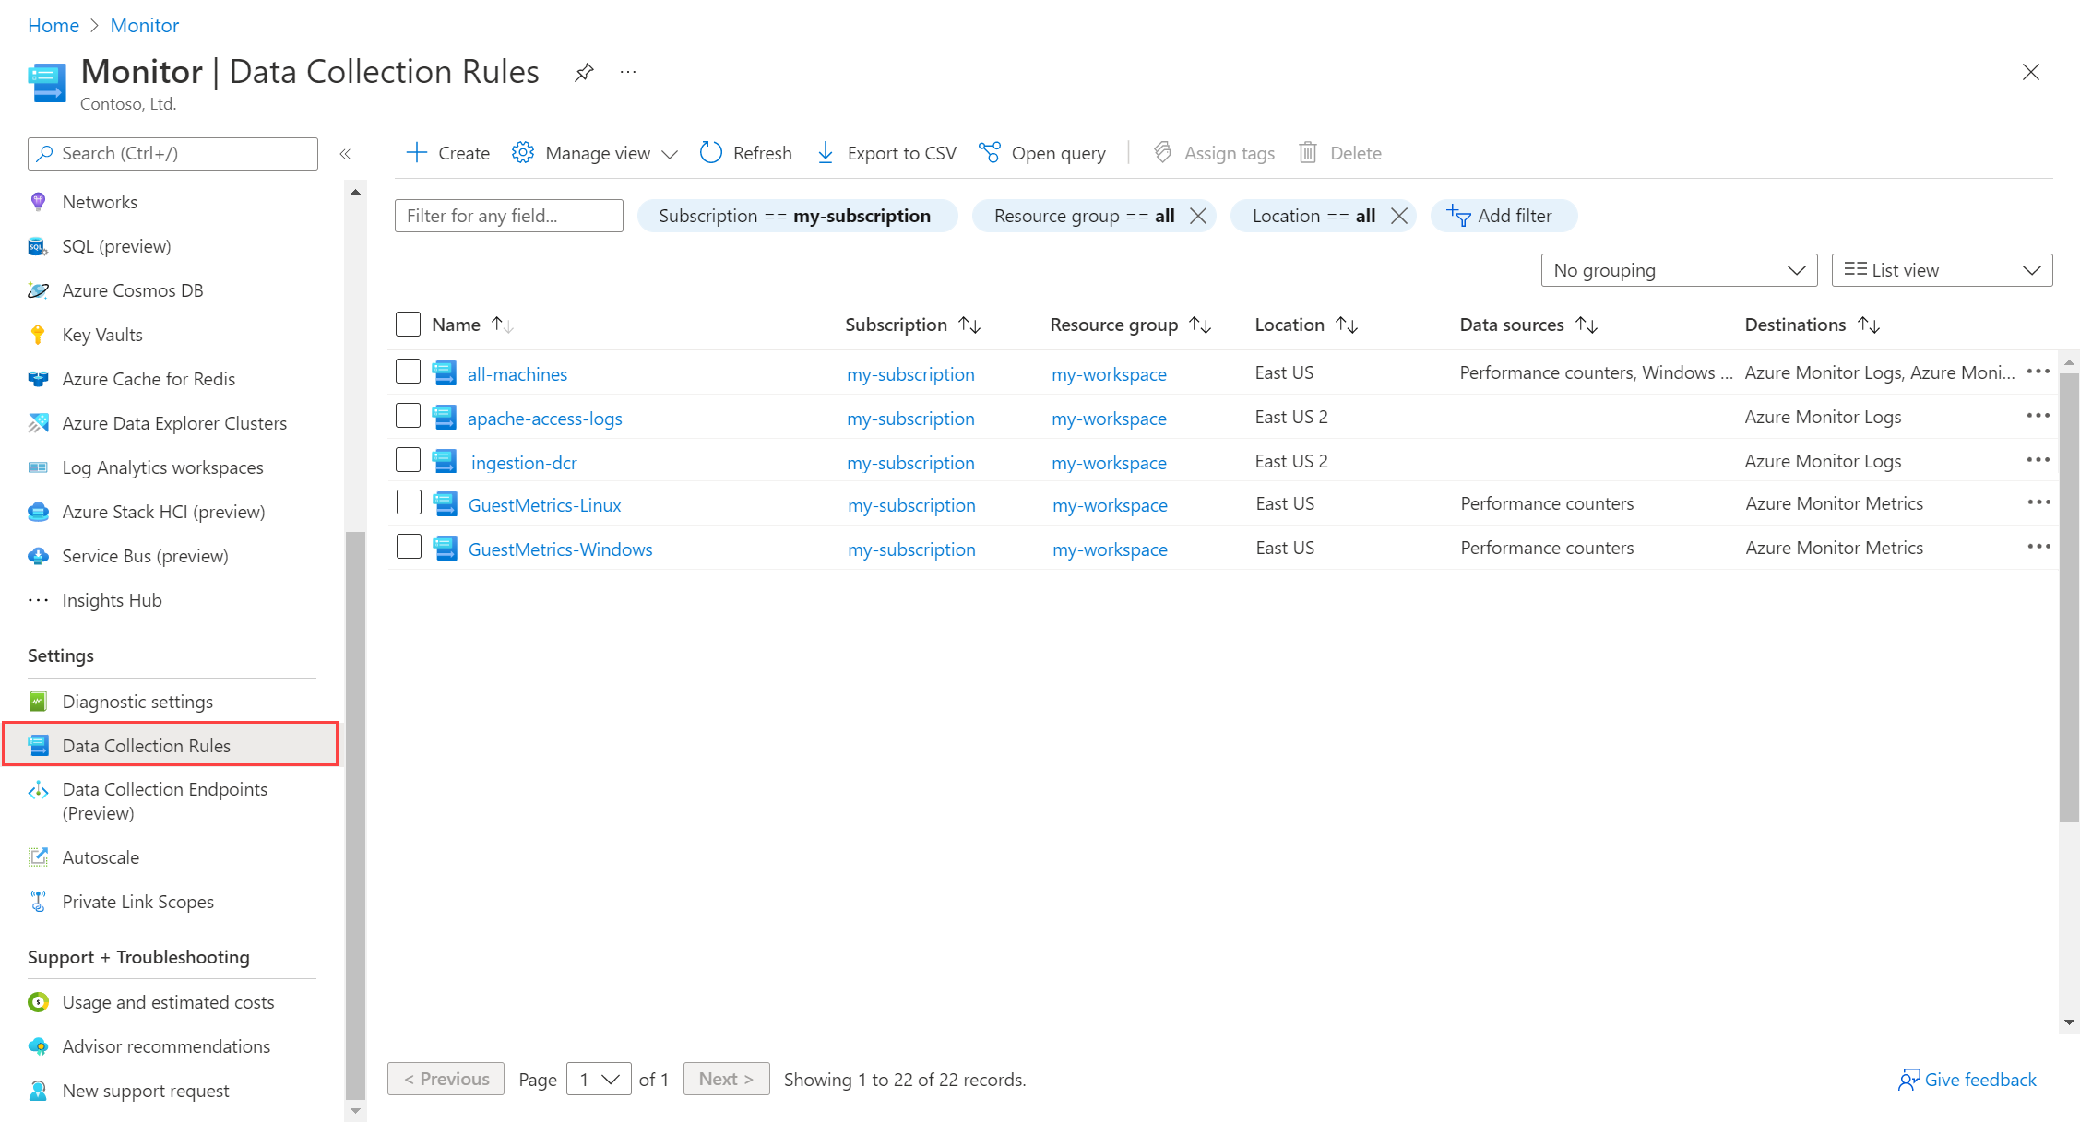
Data Collection Rules
Create via Portal
Notes:
Template for a lecture slide with bullets (if you need them).
Try to NOT use bullet lists in your presentation.
Diagrams, puppy pictures, etc are always better. ☺

Slide 11
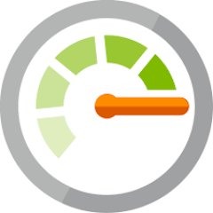
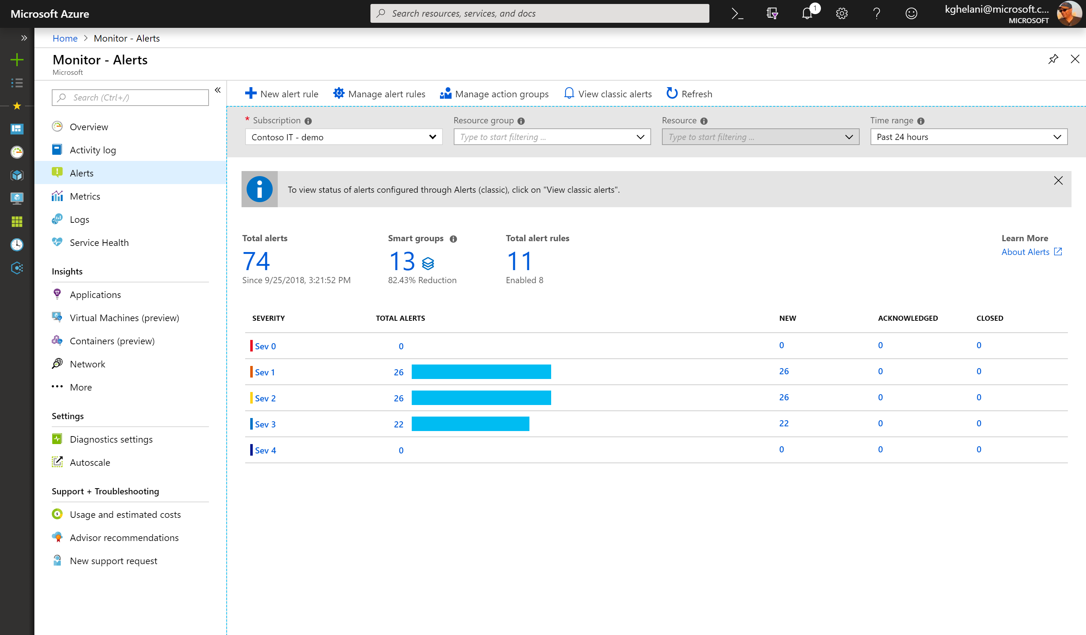
Azure Monitor Alerts
One Alert Mgmt experience
Configure Alerts at Scale Multi-resource alerting
Unified Alert lifecycle Management
Smart grouping to reduce noise
Dynamic threshold base Alerting
Notes:
You can create different types of alerts in Azure Monitor:
A Metric alert rule monitors a resource by evaluating conditions on the resource metrics at regular intervals. Metric alerts are useful when you want to be alerted about data that requires little or no manipulation.
A Log alert rule monitors a resource by using a Log Analytics query to evaluate resource logs at a set frequency. You can use KQL queries to perform advanced logic operations in the condition of the alert rule.
An Activity log alert rule monitors a resource by checking the Activity logs for a new activity log event that matches the defined conditions. For example, you might want to be notified when a production VM is deleted or a Service Health event occurs.

Slide 12
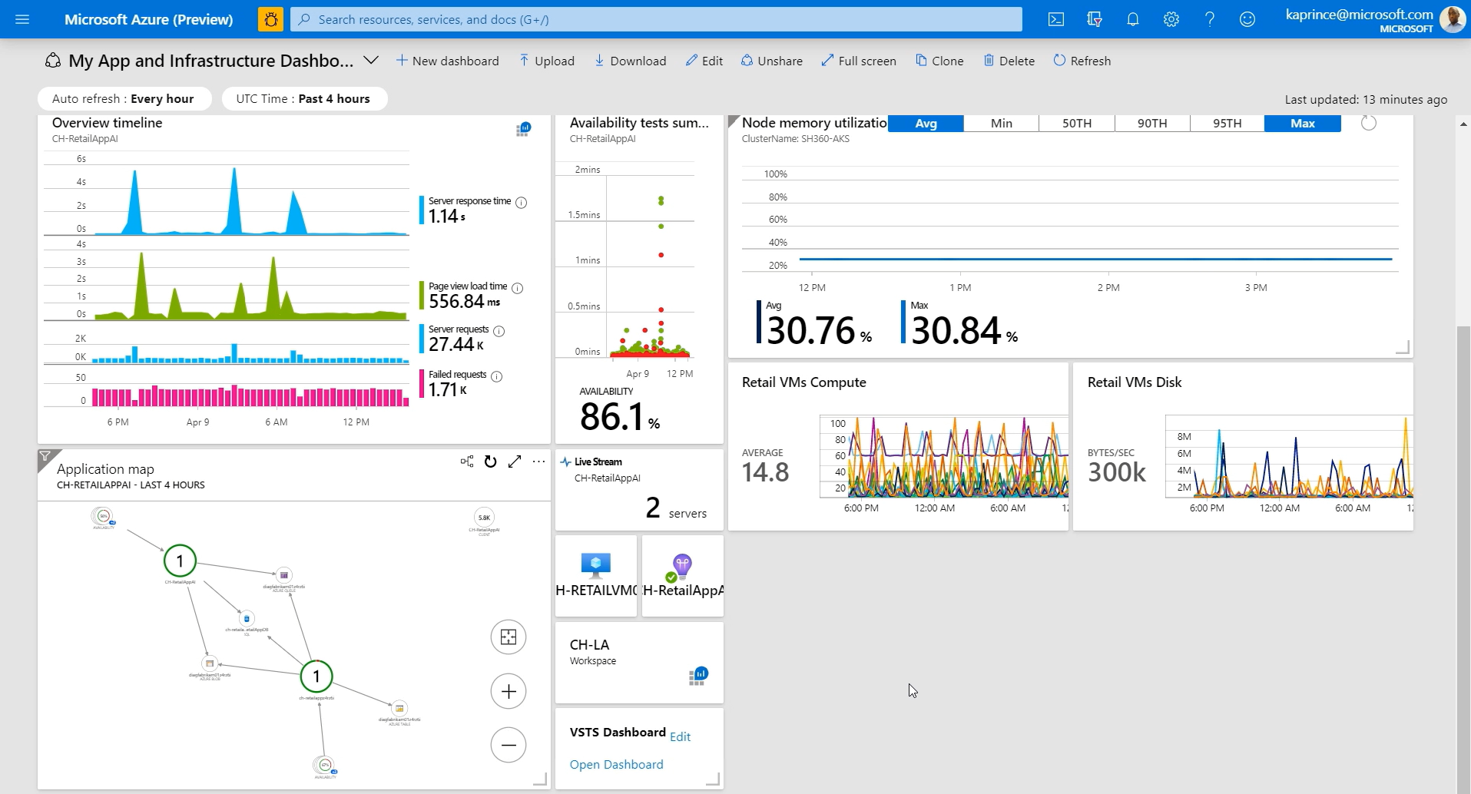
Azure Dashboards
Notes:
Azure dashboards are useful in providing a "single pane of glass" of your Azure infrastructure and services. While a workbook provides richer functionality, a dashboard can combine Azure Monitor data with data from other Azure services.

Slide 13
Challenge #1
Monitoring Basics: Metrics, Logs, Alerts and Dashboards
To accomplish this task, you will need to understand the concept of metrics and logs, how to collect them into Azure Monitor, how to configure different types of alerts, and display results in an Azure Dashboard.
Once you have configured the dashboard, alerts, and diagnostics data to be collected, you will use two tools to simulate a load on the eShopOnWeb resources:
HammerDB - A benchmarking and load testing tool for the world's most popular databases, including SQL Server.
A custom script that produces CPU load on the eShopOnWeb website.
Notes:
For each challenge, list out the key high-level goals.
If there are important specifications, list them here, or remind students to “read the student guide!”

Slide 14
Challenge 2
Setting up Monitoring via Automation
Notes:
There are multiple ways to configure monitoring in Azure. You can configure monitoring manually in the Azure portal like you did in the previous challenge. This is a great way to learn how Azure Monitor works and what settings are available to choose from. However, this method does not scale when you need to configure monitoring across 10s, 100s, or even 1000s of resources in Azure. It is easier to configure monitoring at scale across many Azure resources if you use a declarative Infrastructure-as-Code tool such as ARM templates, Bicep, or Terraform. In addition to that, you can use Azure Policies to ensure that all newly created VMs in the defined scope get required agents installed and all cloud native resources send diagnostics to Azure Monitor (Azure Policies will be explored in the next Challenge).
For this challenge, you will deploy several Metric alerts for your VMs, but this time you will use Bicep templates instead of the Azure Portal. You will get familiar with a new type of alerts - Activity log alert. The Azure Monitor Activity log is a platform log in Azure that provides insight into subscription-level events. The activity log includes information like when a resource is modified or a virtual machine is started.
You will also be asked to install the Azure Monitor Agent on the Virtual Machine Scale Set (VMSS) and configure new Data Collection Rules (DCRs) by using Infrastructure-as-Code approach.

Slide 15





What is Infrastructure as Code?
A way of describing our infrastructure in a machine-usable format.
‘Infrastructure’ doesn’t just mean IaaS.
PaaS and serverless resources
Networks and config
Access control policies
Databases and database objects
Azure resource config
Notes:
I want to be clear, “Infrastructure” as code doesn’t just mean “Infrastructure”
One common misunderstanding is that IaC is just for customers working with IaaS
In fact, IaC can be used across all of your resources:
PaaS and serverless resources, like App Service, Azure Functions, and Logic Apps
Networks, and network configuration like subnets, routing tables, peerings, and NSGs
Access control policies, specifying who can access which resources in your Azure environment
Databases, and database objects like tables, stored procedures, and views
And the configuration of any Azure resource

Slide 16

What is Bicep? For all the current ARM Template gurus
A new declarative domain-specific language (DSL) for deploying Azure resources
Bicep syntax reduces complexity and improves developer experience over JSON
Bicep files ARE considered ARM Templates!
Bicep is a “transpiled” language
During deployment, Bicep files are “transpiled” (or converted) into ARM Templates with JSON as an intermediate language (IL)

Slide 17
How Bicep Works Under the covers
exampleTempate.bicep
Compile ARM Bicep Language
az bicep build –f exampleTemplate.bicep
exampleTemplate.json
Deploy ARM JSON Language
az deployment group create –f exampleTemplate.json…
Azure Resource Manager
Storage
IaaS
PaaS
Data
More!
Notes:
Credit for slide diagram: https://build5nines.com

Slide 18
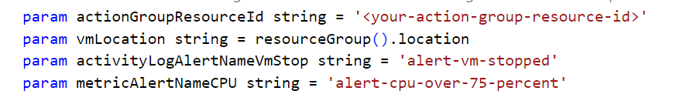
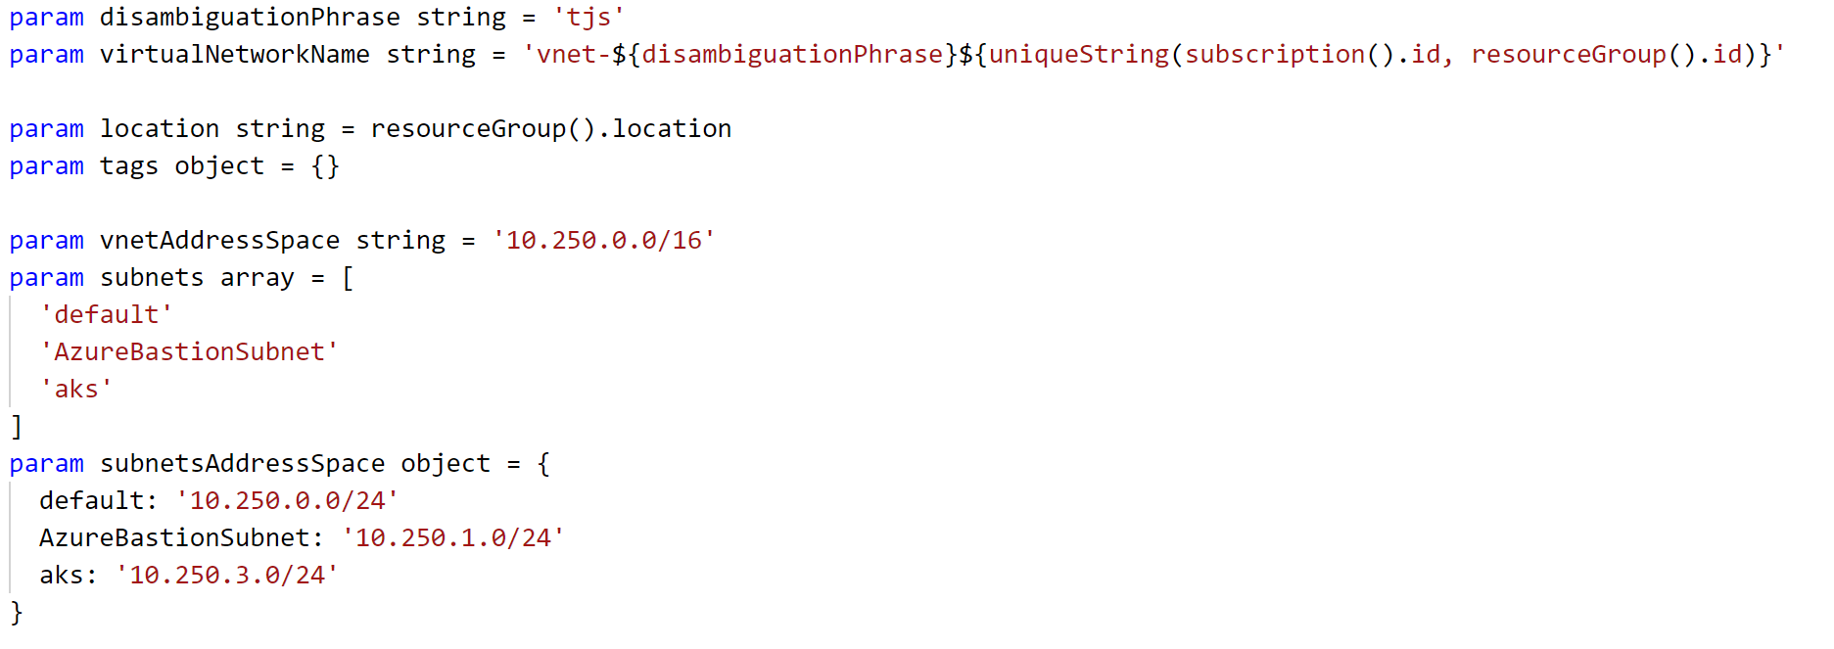
Bicep Template Parameters - Examples

Slide 19
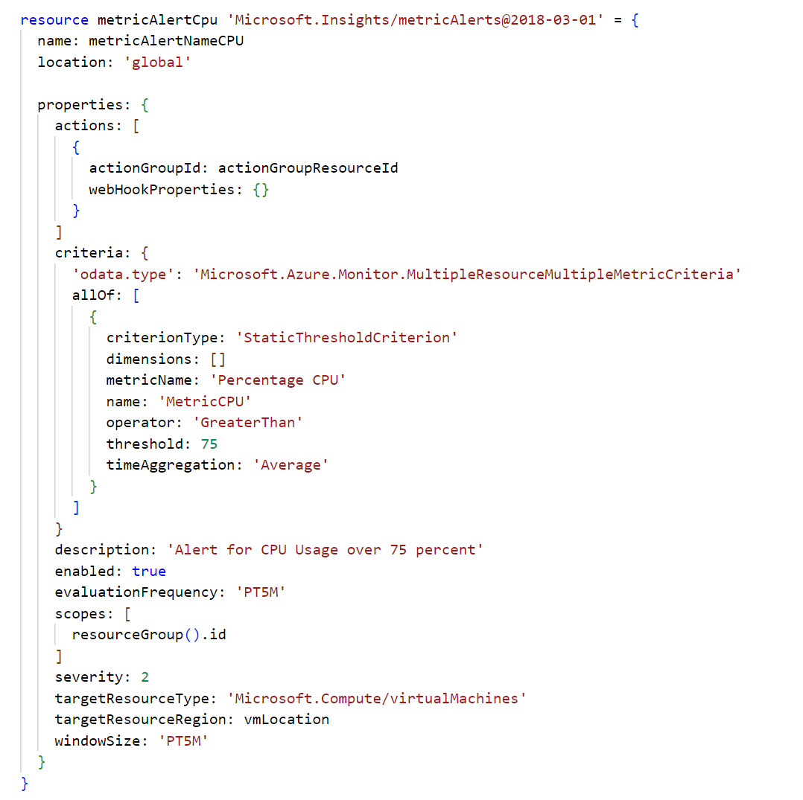
Bicep Template Resources

Slide 20
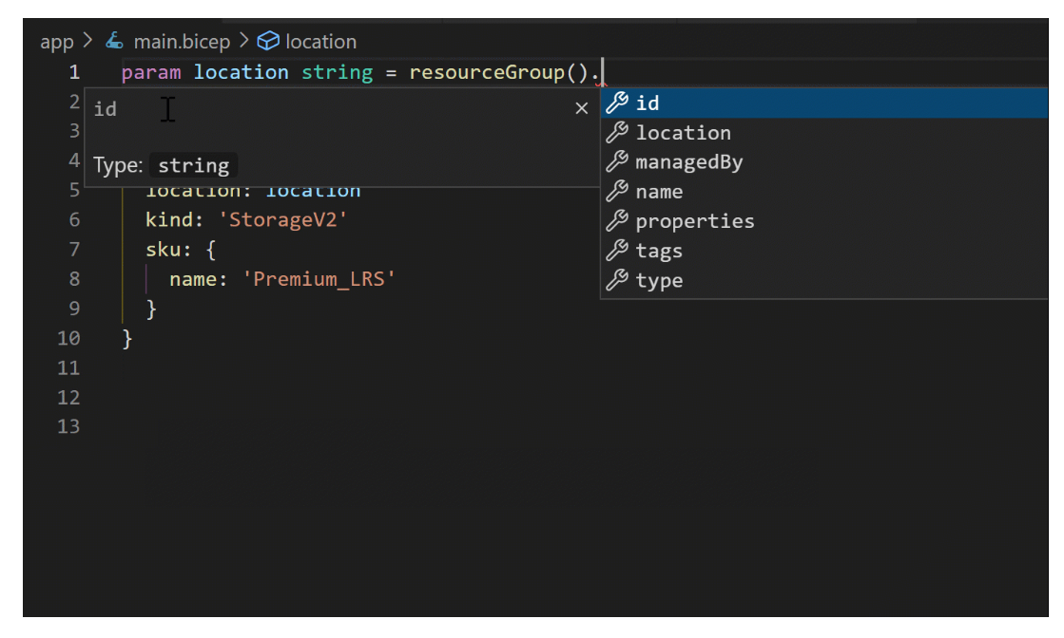
Authoring experience:
VS Code
When you use the Bicep Extension for VS Code to create your Bicep files, you get a first-class authoring experience. The editor provides rich type-safety, intellisense, and syntax validation.

Slide 21
Bicep Template Deployment
PowerShell
PS C:\> New-AzResourceGroupDeployment -TemplateFile exampleTemplate.bicep -Name ExampleDeployment -ResourceGroupName ExampleResourceGroup
Azure CLI
terminal:~$ az deployment group create -f exampleTemplate.bicep –-resource-group exampleResourceGroup -n exampleDeployment

Slide 22
Challenge #2
Setting up Monitoring via Automation
For this challenge, you will deploy several Metric alerts for your VMs, but this time you will use Bicep templates instead of the Azure Portal.
You will get familiar with a new type of alerts - Activity log alert.
You will also be asked to install the Azure Monitor Agent on the Virtual Machine Scale Set (VMSS) and configure new Data Collection Rules (DCRs) by using Infrastructure-as-Code approach.
Notes:
For each challenge, list out the key high-level goals.
If there are important specifications, list them here, or remind students to “read the student guide!”

Slide 23
Challenge 3
Azure Monitor for Virtual Machines

Slide 24
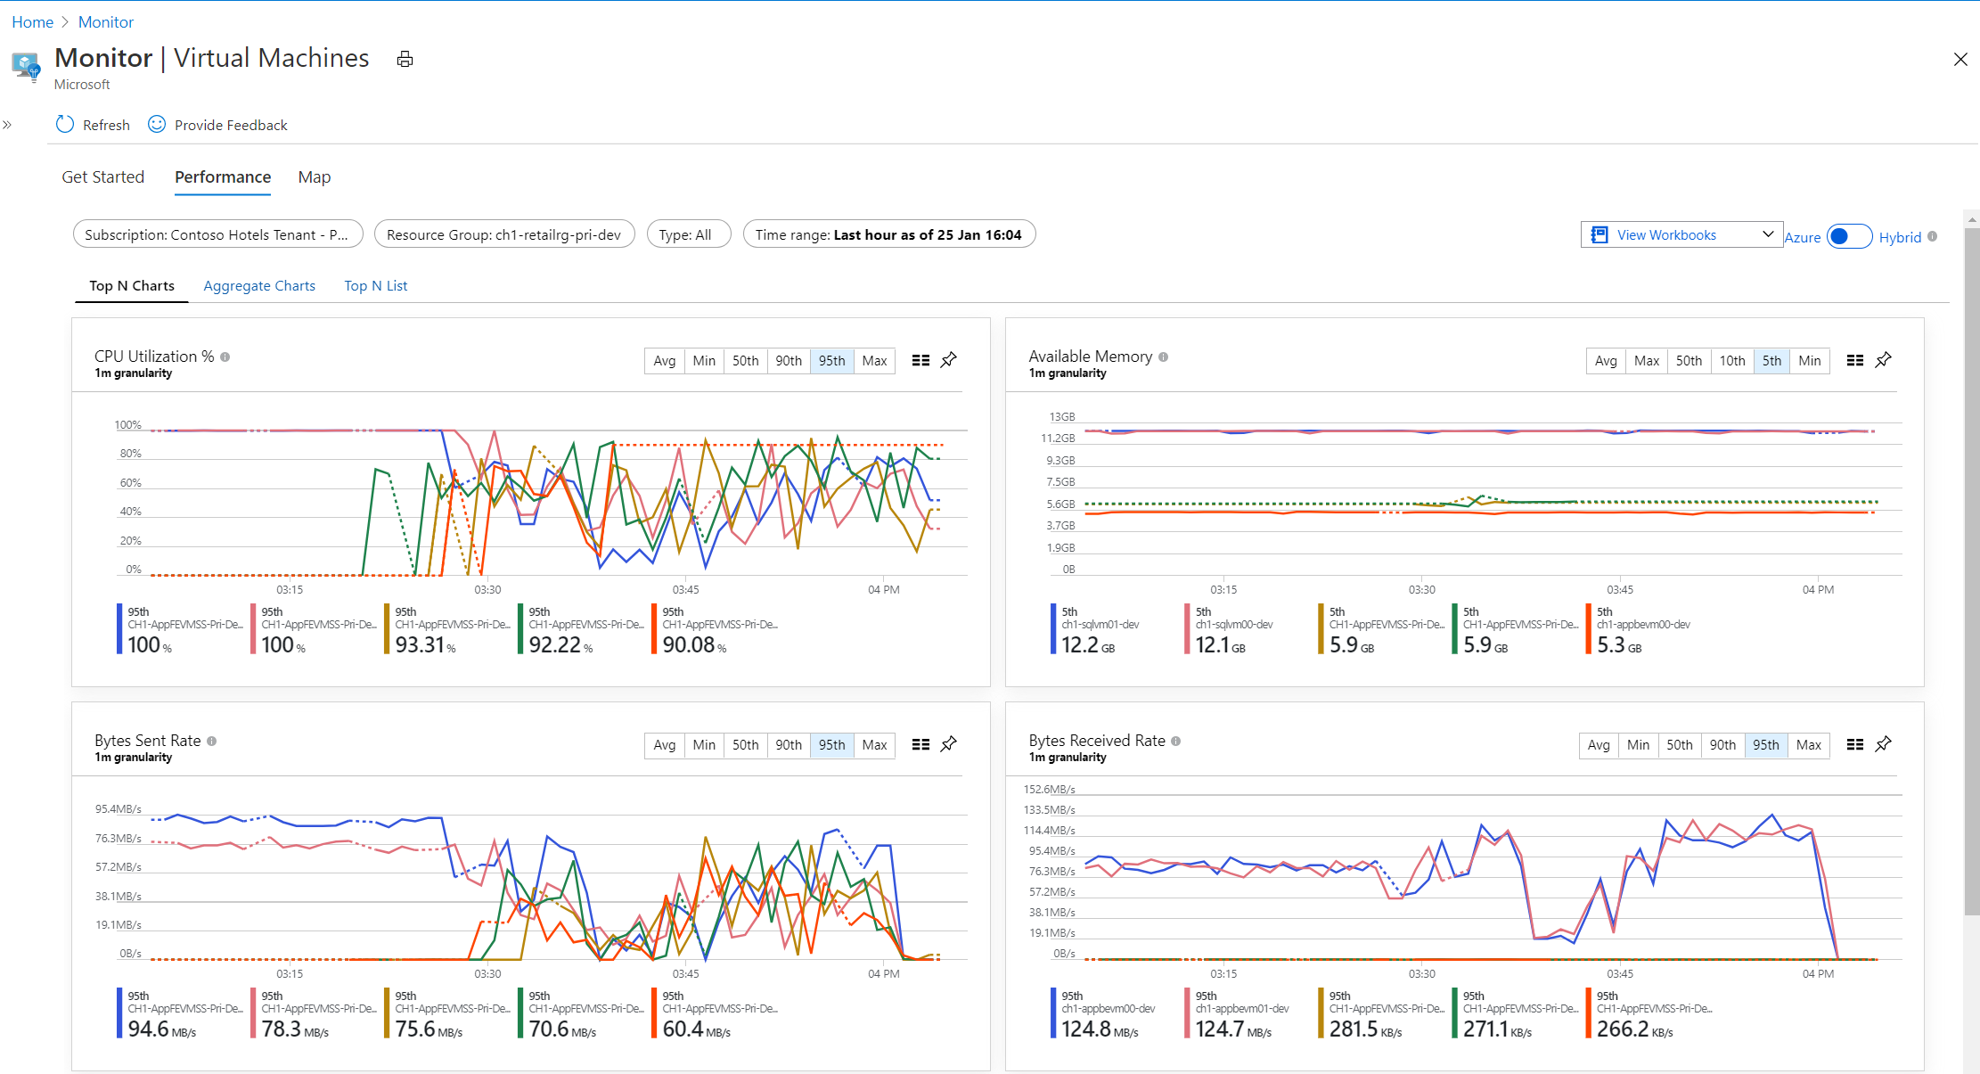
Track resource utilization with Performance charts
Aggregation of VM metrics across thousands of VMs
Top N performance views identify resource constrained VMs @ scale
Drill through performance diagnostics for root cause analysis
Drill through to advanced analytics on VM logs
Built in views for key performance indicators

Slide 25
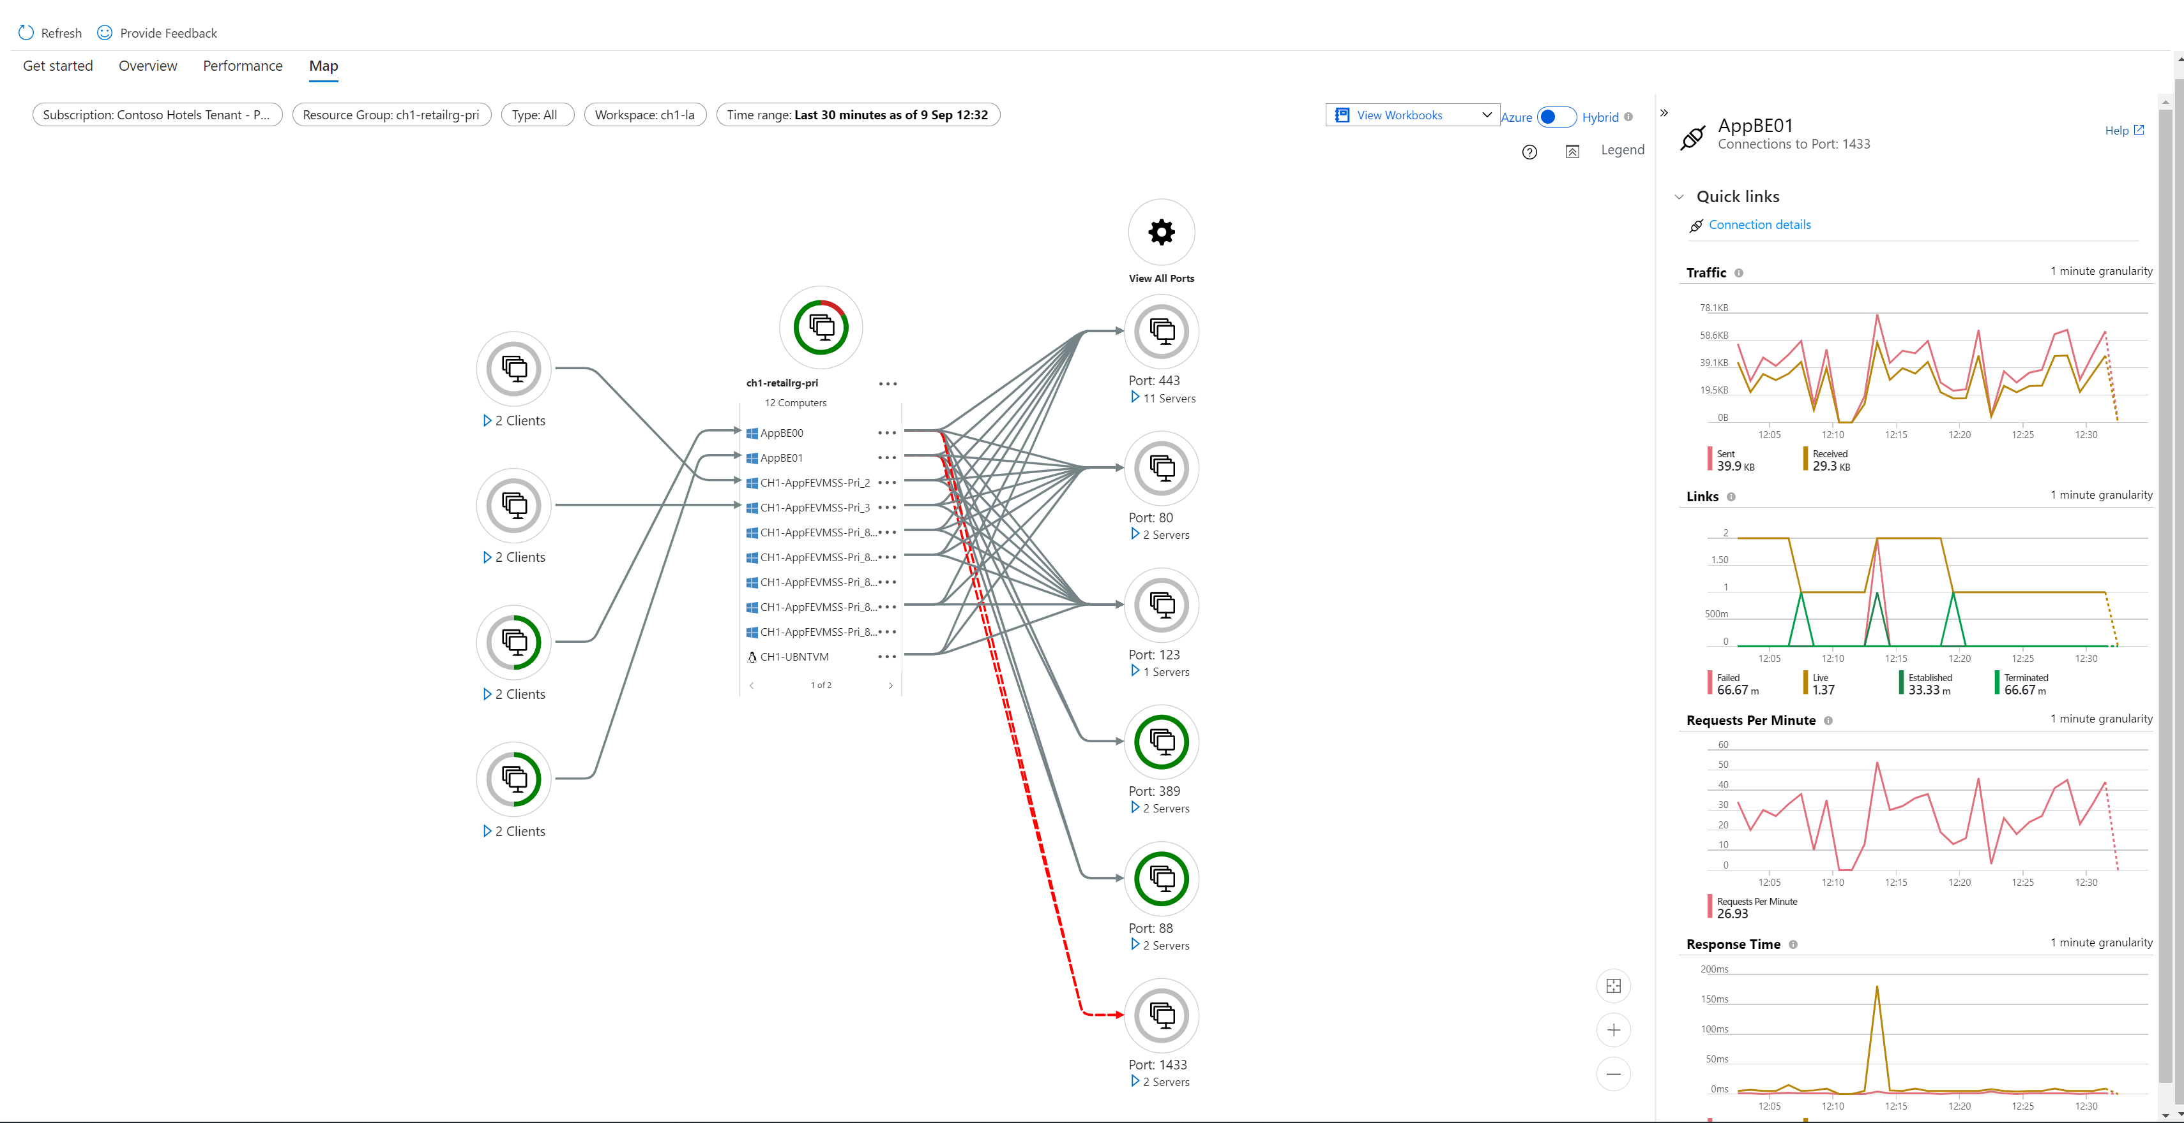
Track processes and dependencies with Map
View VM maps of Azure groups: subscriptions, resource groups, scale sets, cloud service name
Understand dependency paths from processes to remote services
Understand dependency paths between processes
View failed connections
Select a link to get details of connection lifecycle, bytes sent and received, and request count and latency

Slide 26
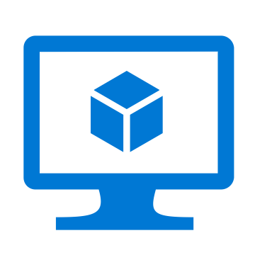
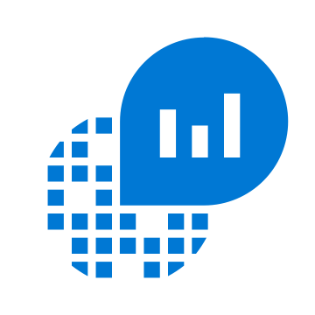
Architecture
Azure Monitor Agent**
+
Dependency Agent
Azure Resources
Logs
On-prem Resources*
VM Insights
*Requires Arc agent to enable VM monitoring
**Onboarding with Log analytics agent (retiring) will only be supported till Aug 2024.

Slide 27
Azure Policy
Active control and governance at scale for your Azure resources
Enforcement & compliance
Apply policies at scale
Remediate & automate
Turn on built-in policies or build custom ones for all resource types
Real-time policy evaluation and enforcement
Periodic & on-demand compliance evaluation
VM Guest Config Policy
Apply policies to a Management Group with control across your entire organization
Apply multiple policies and & aggregate policy states with policy initiatives
Exclusion Scope
Remediate existing resources at scale
Automatic remediation resources at deployment time
Trigger alerts when a resource is out of compliance
Notes:
Azure policy sits at the core of Azure, and gives you the ability to codify your company policies into the platform. Once core benefit is that, given the rate of innovation of Azure, there are services going live quite often. In Azure, any news service will be able to be governed by Azure Policy from day 1.
There are essentially three kinds of policies:
Auditing is the one we recommend getting started with. This means that users can use Azure with no restrictions, but if somebody goes against policy you will be able to see the compliance state in an easy to use view. No need to run scripts every 24 hours to check the compliance status.
Enforce policies is the next level where essentially you are setting guardrails. This means that if you have an enforced policy, users have to do it that way or they will get a deny error.
Remediation is the last type, where you can get back to desired state the resources that are non-compliant. Imagine that you need to have monitoring in your VMs and there are multiple non-complaint ones. You can trigger a remediation policy that will append monitoring to those resources.

Slide 28
Challenge #3
Azure Monitor for Virtual Machines
In this challenge you will explore VM Insights - an additional solution to monitor virtual machines.
You will also have a Bonus task: setting up Azure Policy to automatically enable VM Insights on VMs and Virtual Machine Scale Sets.
Notes:
For each challenge, list out the key high-level goals.
If there are important specifications, list them here, or remind students to “read the student guide!”

Slide 29
Challenge 4
Azure Monitor for Applications

Slide 30
Diagnose E2E issues with Application Insights
Monitor apps in .NET, JS, Java, Node.js or any language with OSS SDKs
Visualize server/client connections & dependencies with App Map
Track E2E distributed transactions
Drill down to code-level with Snapshot Debugging & Profiling
Understand end-user cohorts, behavior & engagement for planning

Slide 31
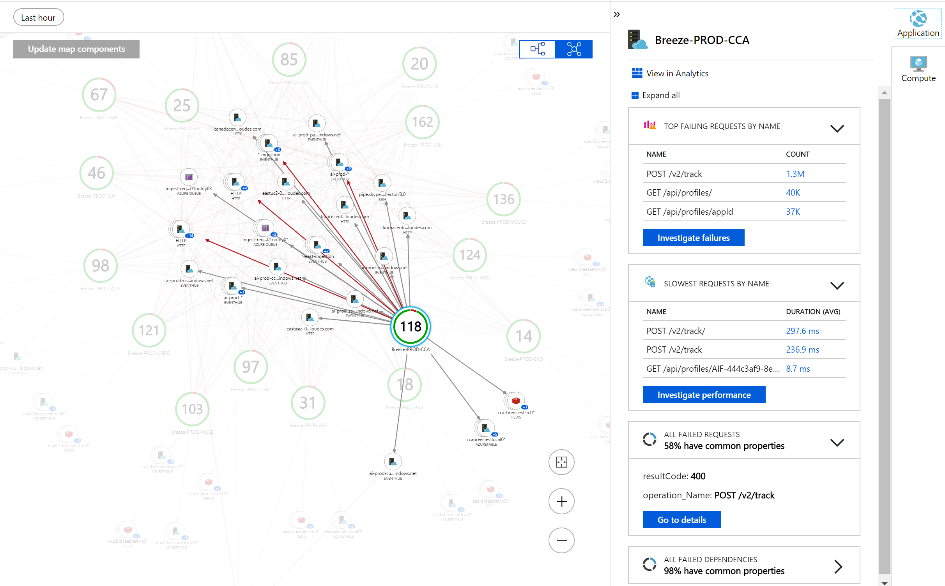
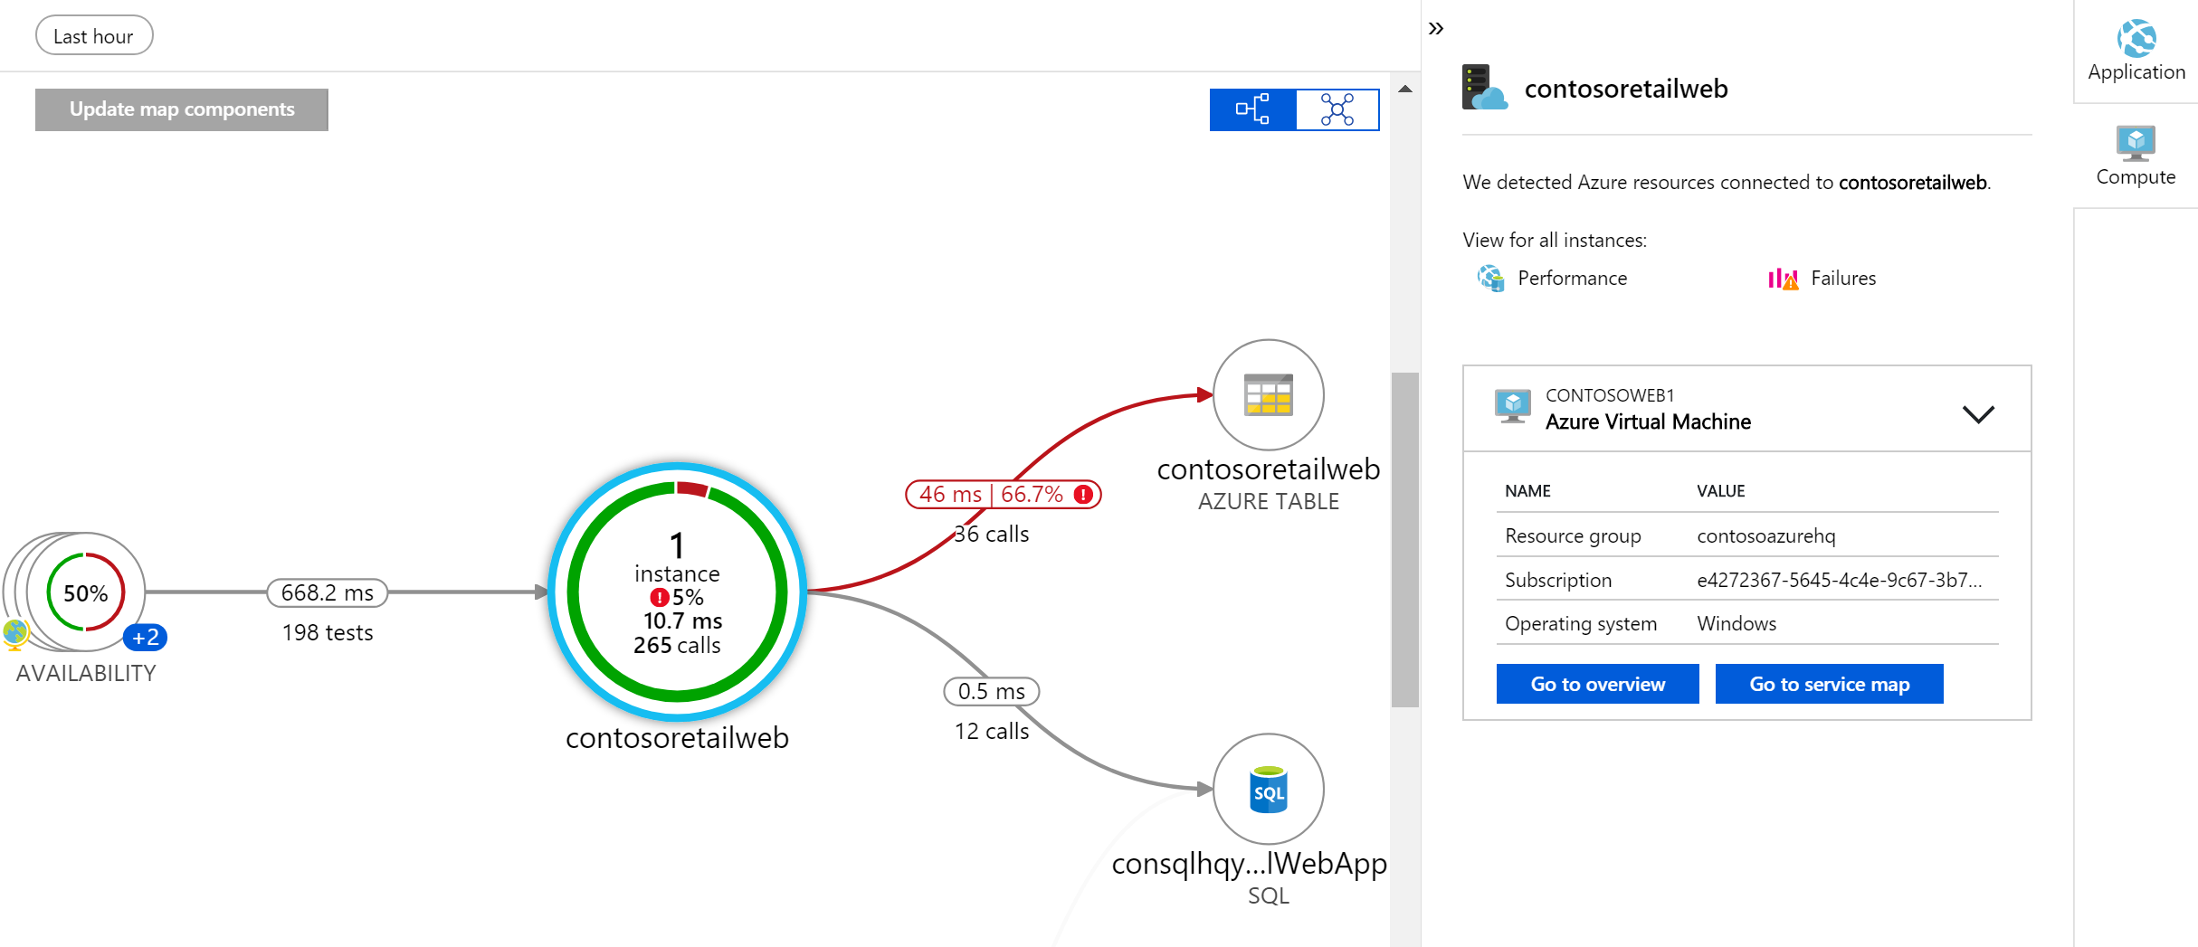
Application Insights
Available on-by-default for Azure App Services & Functions (.NET)
Monitor apps in .NET, Python, Java, Node.js or any other language with OSS SDKs
Distributed tracing via App Map and End to End transaction details
Transition with 1-click from App Map to VM Map for diagnostics
Monitor calls to SQL, Eventhub, Cosmos Db, etc.
Visualize events & metrics in real time with Live Metrics Stream

Slide 32
Common Application Monitoring scenarios
Availability/synthetics
Failure/Performance Diagnostics
Usage
Distributed tracing – App Map & end-to-end transactions
Live Metrics (diagnostics)
Out of Box – workbooks, dashboards, queries etc.
Smart Diagnostics

Slide 33
Challenge 5
Azure Monitor for Containers

Slide 34
Drill down into AKS Containers
Monitor multi-cluster health & node/pod status
View overall perf across nodes, controllers and containers
Analyze Kubernetes event & container logs for troubleshooting
Understand cluster capacity needs under average or heaviest loads
Monitor containers on demand in AKS with virtual nodes

Slide 35
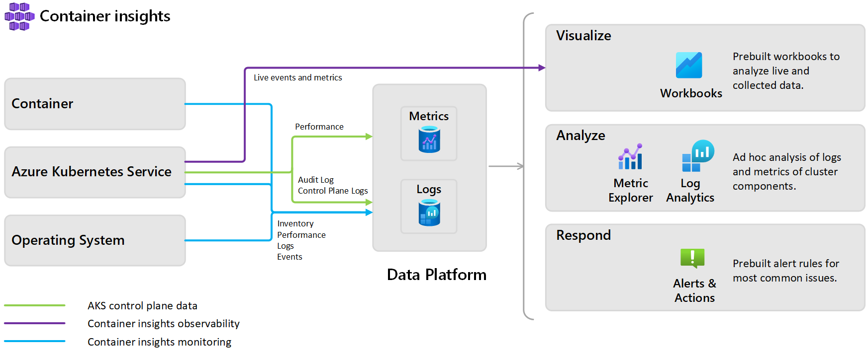
Azure Monitor container insights overview

Slide 36
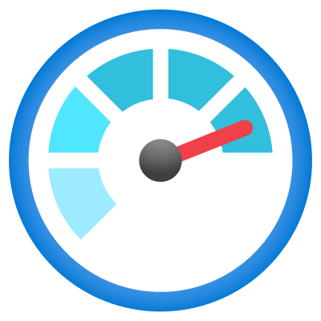
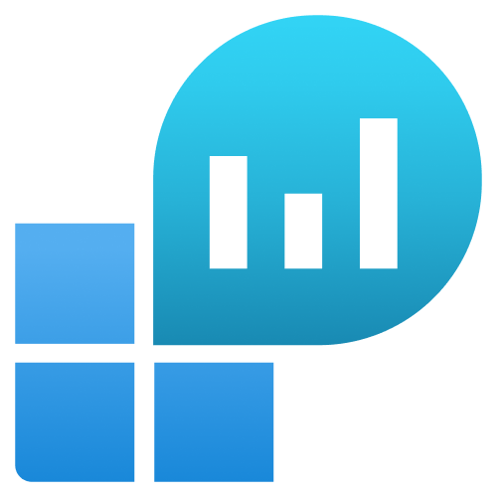

Container Insights – Key Capabilities
Monitoring
View live infrastructure metrics (CPU, Memory, Network, Disk usage)
At-scale management view across all clusters in all subscriptions
Create Azure Dashboards and Workbooks
Analysis
Drill-in features to troubleshoot errors
Query data in Log Analytics
Filter and explore metrics
Alerting
Out-of-the-box recommended metric alerts
Log based alerting
Configuration via action groups

Slide 37
Challenge 6
Log Queries with KQL
(Kusto Query Language)

Slide 38
Advanced Queries with Log Analytics
Log Analytics advanced query experience now in Azure Portal
Central Analytics Platform across Monitoring, Management, Security
Run queries for investigations, statistics & root cause/trend analyses
Utilize ML algorithms for clustering and anomaly detection

Slide 39
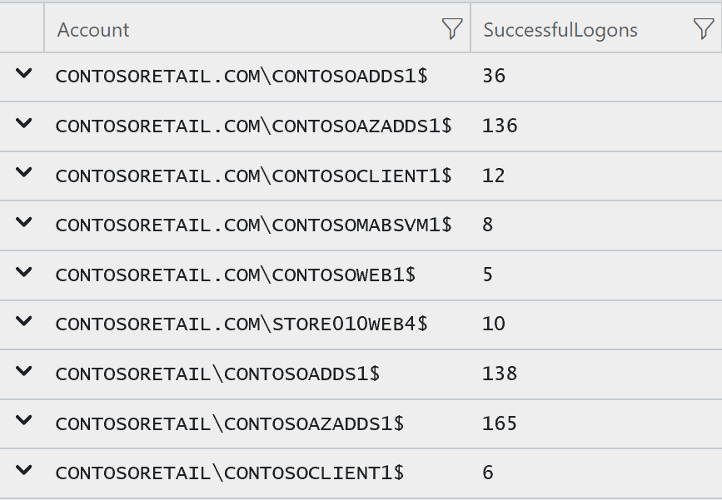
Anatomy of a KQL Query
Table
What?
Data aggregation
Pipe
Command separation
SecurityEvent
| where TimeGenerated > ago (1h)
| where EventID == 4624
| summarize count() by Account
| order by Account asc
| project Account , SuccessfulLogons = count_
Filter
Where?
Data sorting
Modify columns
Notes:
https://docs.microsoft.com/en-us/azure/log-analytics/log-analytics-log-search-new#writing-a-query

Slide 40
Standard data properties
Some standard properties which are common across multiple data type:
Property | Description
TimeGenerated/timestamp* | Date and time that the record was created by the data source.
_TimeReceived | Date and time that the record was received by the Azure Monitor
Type/itemType* | The name of the table the record was retrieved from
_ItemId | Unique identifier for the record.
_ResourceId | Unique identifier for the Resource that the record is associated with.
_IsBillable | Specified whether ingested data is billable.
_BilledSize | Specified the size (in bytes) of data that will be billed to your Azure account if _IsBillable is true.
* Timestamp and ItemType are used in Application Insights
Notes:
https://docs.microsoft.com/en-us/azure/azure-monitor/platform/log-standard-properties

Slide 41
Challenge 7
Visualizations
with Azure Monitor Workbooks

Slide 42



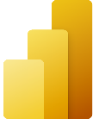
Visualizations: Dashboarding & Reporting
Grafana
Multi-cloud, multi-platform, single-pane-of-glass visualizations
Best with Prometheus
Out-of-the-box plugins from most monitoring tools/platforms​
Dashboard templates w/ focus on operational use-cases
Supports portability, multi-tenancy and flexible RBAC
Azure Managed Grafana for seamless integration with Azure
Azure Workbooks
Native reporting platform in Azure with at-scale deployments, RBAC and no additional costs
Great fit for Azure/Arc exclusive environments​
Designed for collaborating & troubleshooting​
Out-of-the-box reports/templates which are fully customizable
Leveraged by many Insights in Azure Monitor for curated views
Azure Dashboards
Native dashboarding platform in Azure with at-scale deployments, RBAC and no additional costs​
Great fit for Azure/Arc exclusive environments​​
Power BI
Helps design business centric KPI dashboards for long term trends
Supports BI analytics with extensive slicing & dicing

Slide 43
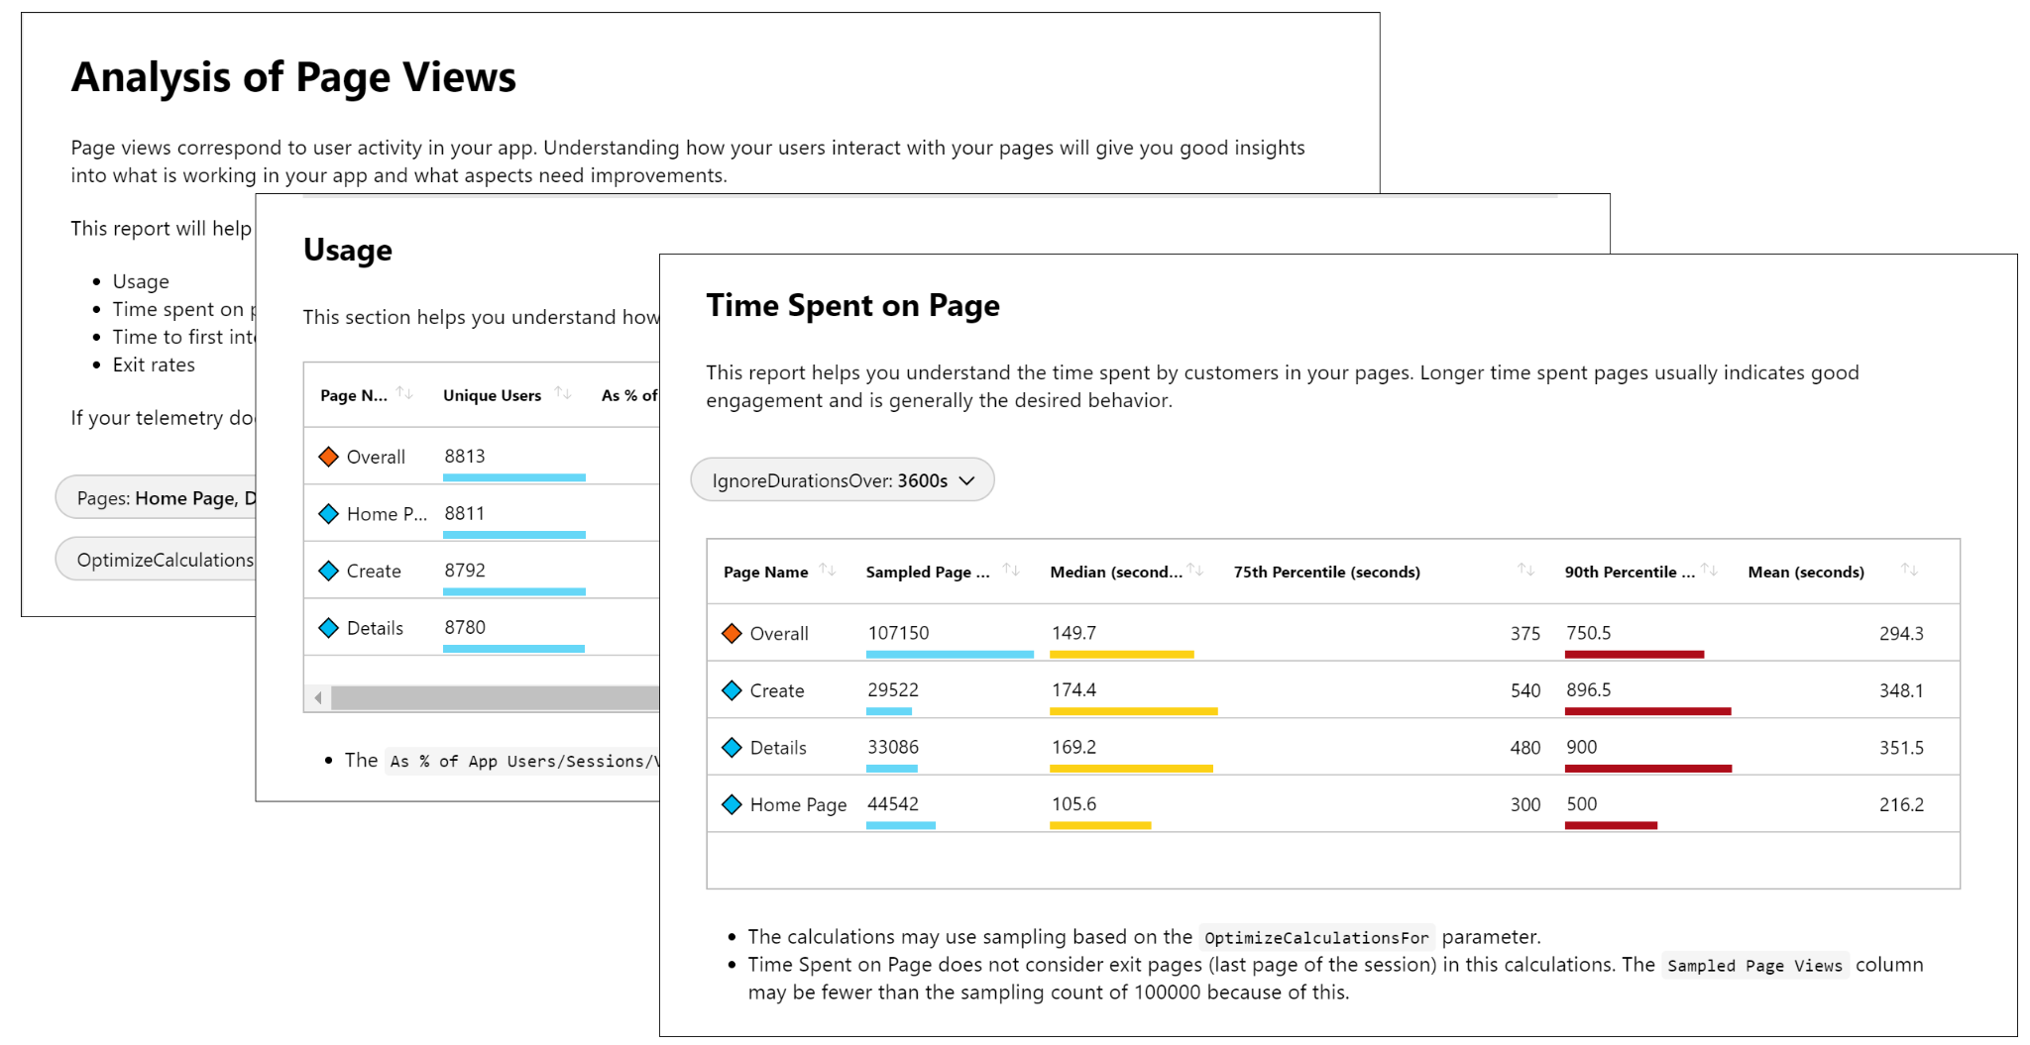
Workbooks
Workbooks provide a flexible canvas for data analysis and the creation of rich visual reports within the Azure portal.
They allow you to tap into multiple data sources from across Azure and combine them into unified interactive experiences.

Slide 44
Thank You for Attending!
https://aka.ms/wth
Notes:
Thank students for attending and share the link to the What The Hack website with them.

